Slide 1
Developing Human Resources + Broadening Participation

Slide 2
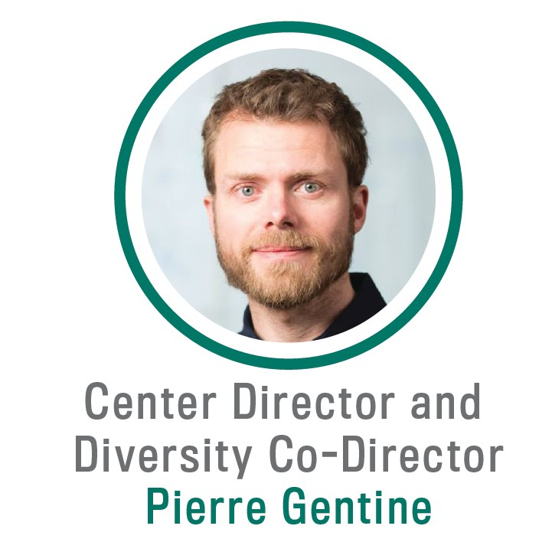
Associate Professor of Earth + Environmental Engineering, Associate Professor of Earth + Environmental Sciences, Columbia University
PhD, Civil + Environmental Engineering, MIT
Expertise
  Hydrologic cycle
  Land-atmosphere interactions
  Machine learning for geoscience
Other Synergistic Experience
  Co-Founder + Co-Lead, Data Science Working Group,
  US CLIVAR
  Co-Lead, NOAA Drought Task Force
  Member, Working Group on Seasonal to Interannual Prediction, World Climate Research Program

Slide 3
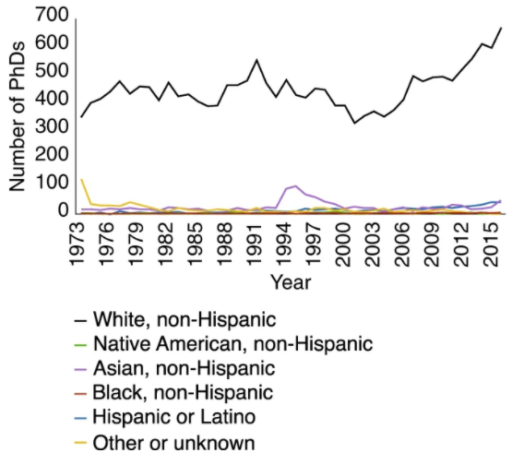
Geoscience’s Homogeneity Impedes Progress
Geosciences are not diverse, equitable, or inclusive
Racial diversity has not increased in 40 years
Underrepresented minorities exit at higher rates
Prior efforts have been unsuccessful
  Why is there underrepresentation?

Slide 4
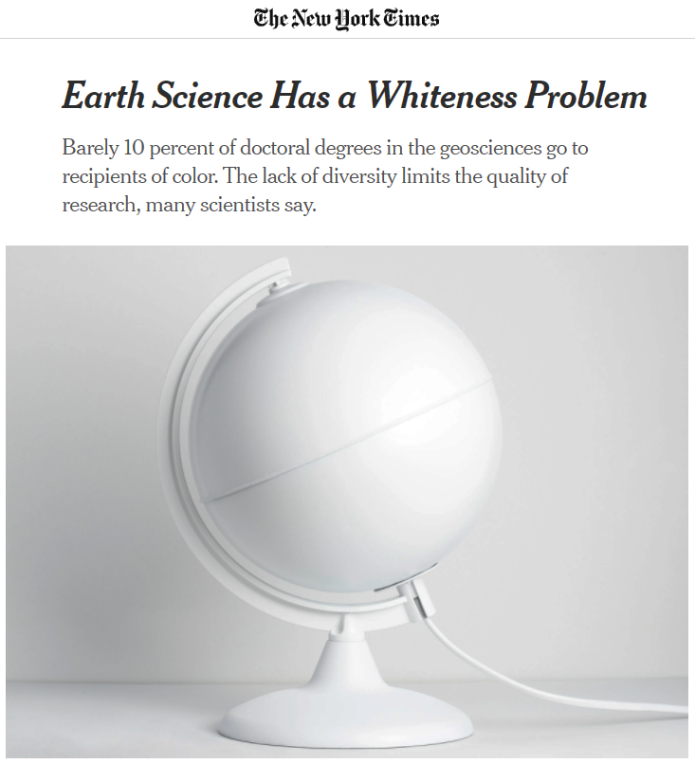
Inequity in Geoscience is Highly-Visible
“A lack of diversity + inclusion is the single largest cultural problem facing the geosciences today” - Dr. Kuheli Dutt, Lamont-Doherty Earth Observatory
“[The] lack of representation in turn affects the quality + focus of earth science research, especially on climate change”
- Emma Goldberg, NYTimes

Slide 5
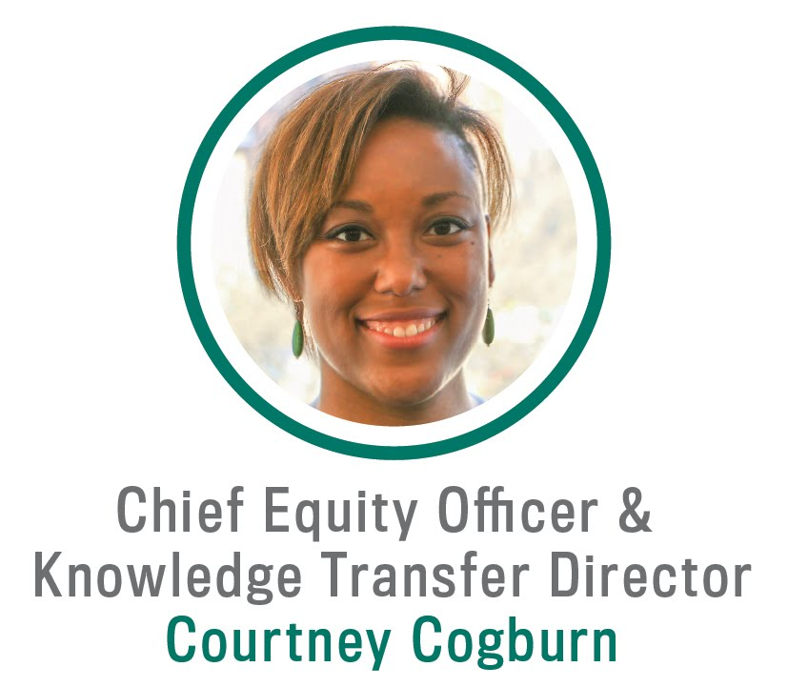
Associate Professor of Social Work, Columbia
  Faculty, Population Research Research Center
  Core Member, Data Science Institute
PhD, Education + Psychology, Michigan
Expertise
  Structural + cultural racism
  Race-based health inequities
  Virtual reality education, emerging tech + social justice
Other Synergistic Experience
  Member, Columbia Climate School Faculty Task Force
  Member, Columbia Climate School Design Committee
  Faculty Advisor, SW Climate Action Initiative
  Co-Chair, Computational Social Science Working Group
  Co-Director, Justice, Equity + Tech Laboratory
  Lead Creator VR Experience, 1000 Cut Journey

Slide 6
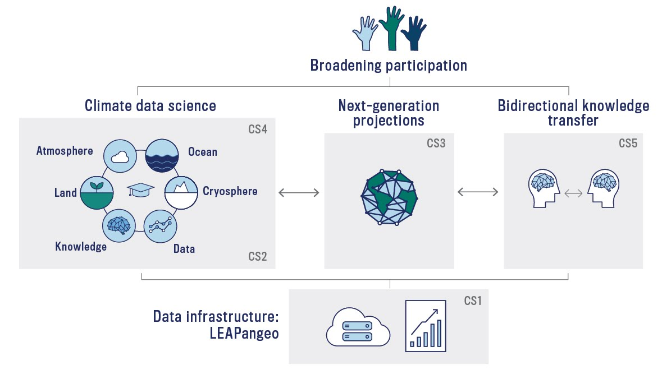
Our Roadmap
LEAP forward in the reliability, utility, and reach of climate projections through synergistic innovations in data science and climate science.

Slide 7
Broadening Participation Overview
Explain why DEI is critical to LEAP’s intellectual merit + broader impact goals
Highlight LEAP’s vision for Broadening Participation + Knowledge Transfer strategies
How + why does LEAP promote “bidirectional knowledge” exchange with external stakeholders?

Slide 8
Science * Humanity * Society
Climate change will cause an imbalance in human suffering
Focusing on most marginalized + vulnerable will be necessary to meet the hallmarks of democracy, prosperity + sustainability
LEAP science cannot exist in a vacuum - broadening participation is integral to climate data science
DEI + LEAP is critical.

Slide 9
DEI is Critical for LEAP’s Broader Impacts
Address needs of most vulnerable communities
Engage with multiple public + private stakeholders
Bidirectional Knowledge Transfer: vulnerable communities + other stakeholders possess valuable knowledge + strategy
Climate Data Science must meaningfully + substantively reach beyond the university

Slide 10
Why Center the Marginalized + Vulnerable?
Black + Hispanic communities in the US are exposed to more air pollution than they produce
Climate change will cause the most economic harm in the nation’s poorest counties - home to mostly people of color
Coastal (largely Black) communities in the South are at greatest risk from sea level rise
Discriminatory housing policies (e.g. “redlining”) are tied to Black communities having more pavement, fewer trees + higher average temperatures

Slide 11
DEI is Critical for LEAP’s Research
Questions asked, problems + solutions identified, are influenced by who we are
Richer questions, problems + solutions emerge from diverse teams
  US needs teams equipped to address complex social ecologies
LEAP’s ability to impact society is improved
if LEAP looks like society

Slide 12
We Must Interrogate Why the Geosciences are Inequitable
Established Problems
Leaky pipeline
Insufficient mentorship
Implicit bias in recruitment
Expanded Framing
Homogeneous networks
Segregated diversity efforts
Focus on bias, not systems
LEAP targets all three identified problems + employs an expanded approach.

Slide 13
Leveraging DEI Best Practices

Slide 14
LEAP Sets 3 Measurable DEI Objectives
DEIO1: Integrate LEAP’s vision into recruitment, research, education + knowledge transfer efforts
DEIO2: Increase representation of URMs in the burgeoning climate data science discipline
DEIO3: Assess, review + revise all LEAP activities through an explicitly DEI lens

Slide 15
LEAP’s Approach: DEI in Everything
Strategically leveraging best practices + innovation
DEI ecosystem focused on structural + cultural solutions
Invest in increasing URMs in climate data science
Assess, share + adapt

Slide 16
LEAP Leverages Best DEI Practices
Best Practices
LEAP Response
Leadership is 45% women, 27% POC
HS to Post-Doc Educational programming
Partnerships with racial + ethnic minority-led institution
Partners with strong recruitment infrastructure
Emphasizing broader impact goals in recruitment with:
  Staff Writer
  Assistant Director for Inclusive Education
  Knowledge Transfer Program Manager
Diverse leadership
Strengthen the pipeline
Leverage key partnerships
Integrate DEI into recruitment + engagement

Slide 17
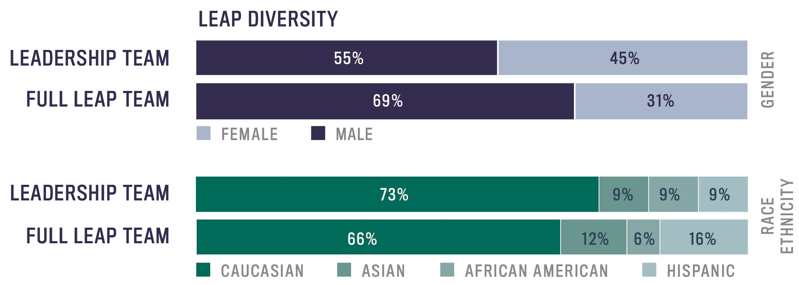
LEAP’s Team is Highly-Diverse, but We’re Still Growing...
But we can do better.
We must do better.

Slide 18
Leveraging Prior DEI Successes

Slide 19

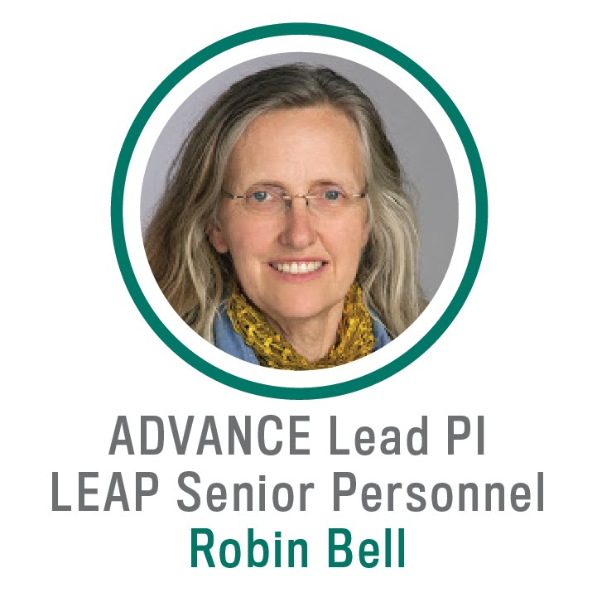
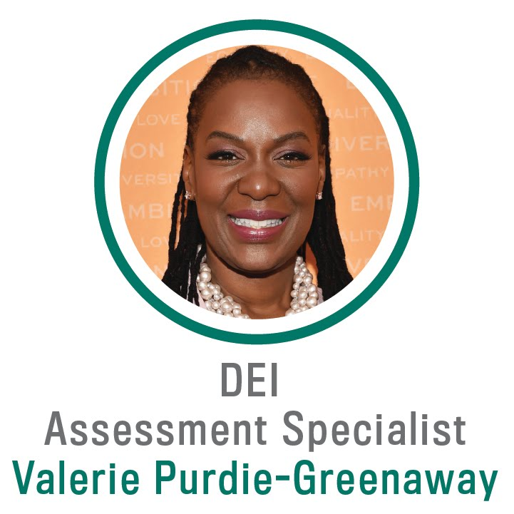

LEAP Builds Upon Groundbreaking Work of its NSF ADVANCE Program
$4.2M NSF investment in Columbia, 2004-2009
  Lead PI: Robin Bell, LEAP
  Implicit Bias Trainer: Valerie Purdie-Greenaway, LEAP
  Began addressing cultural + systemic barriers
  for women in environmental science
Synergistic Outcomes
Best Practices for LEAP
Women environmental science teaching faculty increased from 2% → 40%
  2% → 30% of environmental research faculty
New Lamont-Doherty Office of Diversity
Environmental Science Cluster Hire
Implicit bias training for recruitment
Maureen Raymo as first Lamont-Doherty Director → first woman, first climate scientist
Gender ≠ race/ ethnicity
Individual recruitment does not create lasting change
  Cultural + systemic reflection is necessary
Science of diversity dialogue positions teams for sustained equity
Must use evidence-based DEI interventions, specifically with recruitment

Slide 20
“Bridge” Postbacs Strengthen a Pipeline of Graduate Researchers
Race/ Ethnicity or Gender | Number of Bridge Alumni
Black | 23
Latinx | 20
Middle Eastern | 5
Asian | 4
White | 4
Female | 33
Male | 24
Columbia’s Bridge to PhD Postbac Program
  URMs in STEM labs for two-year assistantships
  Offers professional development
    Interview skills + presentations coaching
  Mentors graduate applications
Bridge works! Since 2008:
  57 students trained
  68% PhD acceptance
LEAP will supports 3 Bridge Postbacs per year

Slide 21
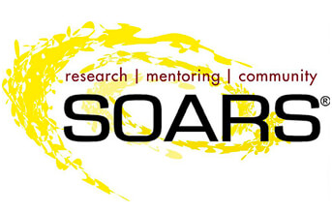
LEAP Will Mentor Diverse Pre-College Climate Scientists
Significant Opportunities in Atmospheric Research + Science
  UCAR’s Bridge program for URM students
  90% of SOARS proteges enter graduate school
Year 1: LEAP-led workshop for SOARS protégés
Years 2-5: LEAP postdocs + students virtually mentor protégés
  Mentorship program annually evaluated + refined

Slide 22
Pushing DEI Innovation

Slide 23
3 Areas of Innovation
Breadth and Depth of Broadening Participation
DEI Ecosystem: DEI in Everything
Assessing, sharing + adapting DEI strategies

Slide 24
Pushing Innovation
Breadth and Scope of Broadening Participation
Comprehensive Pipeline Programming
  High school students
  Undergrad + grad students
  Postdoc
  Parents
  Teachers
  Journalists
  Companies
Translate-a-thon
Public Conversations
Storytellers in Residence
Journalism Workshops
Design Studio
Science Museum Outreach Programs
Train-the-Trainer
Lab to School
Expanded partner network
Convergence Luncheons
“Ask me Anything”

Slide 25




Annual Hack-a-thon =
Life-Relevant Learning
Years 1-3 Hack-a-thon spanning Knowledge-Data Continuum
  Heavily utilizing LEAPangeo
Co-organized with NYC Office of the Mayor + BlackSpace
Marketed by National Society of Black Engineers
Hosted on Governors Island to showcase
climate change risks in action

Slide 26
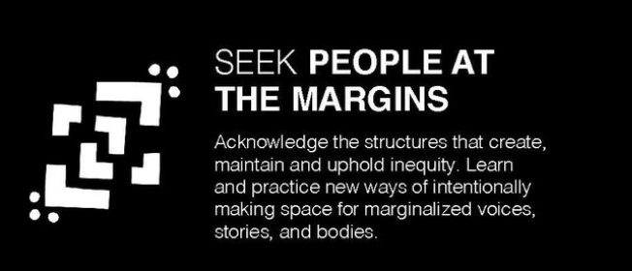

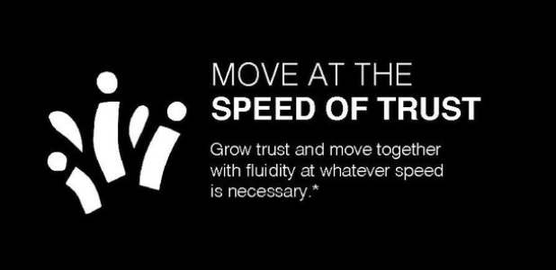

Slide 27
Suffusion: LEAP Integrates Education, DEI + KT
Bridge to PhD program
Climate Justice Leadership Board
Candidate Evaluation Experiment
Hack-a-Thon
SOARS Integration
Convergence Luncheons
Translate-a-Thons
Science Museum Outreach
Open-Source Education Products
Education
Knowledge Transfer
Diversity Equity + Inclusion

Slide 28
Pushing Innovation
Suffusion
Establish DEI grounded center culture - transdisciplinarity, transparency, comprehensive broadening participation, education + knowledge transfer initiatives
Management Structure, subcommittees, Climate Justice Leadership Board
DEI Orientation: Establishing a shared vision + strategy

Slide 29
Pushing Innovation
DEI Orientation
Equity Literacy + Visioning
All LEAP researchers, trainees + administrators will complete DEI workshops
Funding prioritized to applicants who completed workshops
Equity Planning
Annual Performance Review

Slide 30
Pushing Innovation
Assess, Share + Adapt
Blind applicant names + institutional affiliations for:
  Fellowships
  Postdoc traineeships
  REU programs
  Internships
  Seed funding
Utilize work samples
Standardized interviews
Randomized field experiment

Slide 31
Recruitment is Itself a Research Frontier
Multi-phase hiring
Blinding applicant name + institutional affiliations
Work samples
Standardized interviews

Slide 32
Recruitment is Itself a Research Frontier
Randomized Field Experiment
Pilot 1: REU
Pilot 2: Seed Funding
Research Design
  Treatment 1: Single-phase
    Blinded CV/ resume
  Treatment 2: Multi-phase
    T1 + work sample, standardized interviews
  Present + Publish

Slide 33
DEI Strategy: Assess, Share + Adapt
Multi-methodological Strengths, Weakness, Opportunities + Threats (SWOT) Analysis
Survey, interviews, lab-based ethnography, comprehensive review
Build Inclusive Science Module
Publish + adapt

Slide 34
Knowledge Transfer is DEI

Slide 35
LEAP’s Knowledge Transfer Grows Out of its DEI in Everything Commitment

Slide 36
LEAP Sets Three Knowledge Transfer Objectives (KTO)
KTO1: Establish a bidirectional dialogue between academia, industry, non-profits + the public
KTO2: Innovate storytelling, visualization + social media for broad stakeholder intake
KTO3: Make all LEAP research open-source + broadly accessible

Slide 37
Knowledge Transfer Stems from LEAP’s DEI Commitments
Research + education + knowledge transfer seeks societal betterment
+ Better societies are more diverse, equitable + inclusive
= DEI in Everything
Education, Corporate + Public Engagement, DEI are all Knowledge Transfer
LEAP must understand + engage heterogeneous interests in climate
Knowledge transfer must emerge from DEI commitments
  Cogburn as Chief Equity Officer + Knowledge Transfer Director

Slide 38
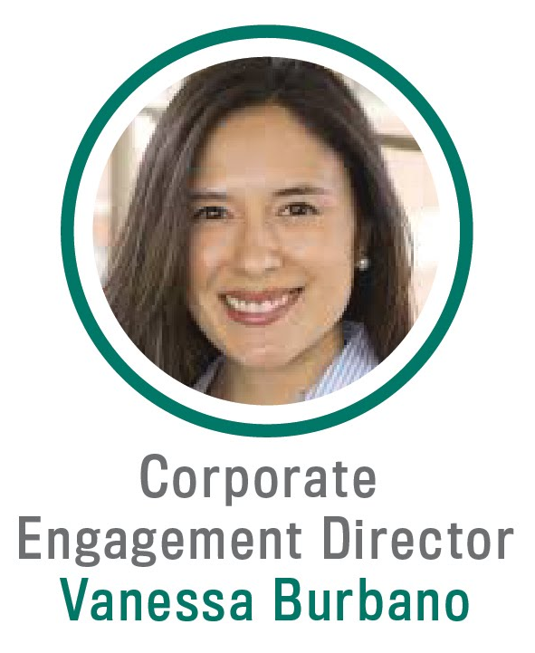
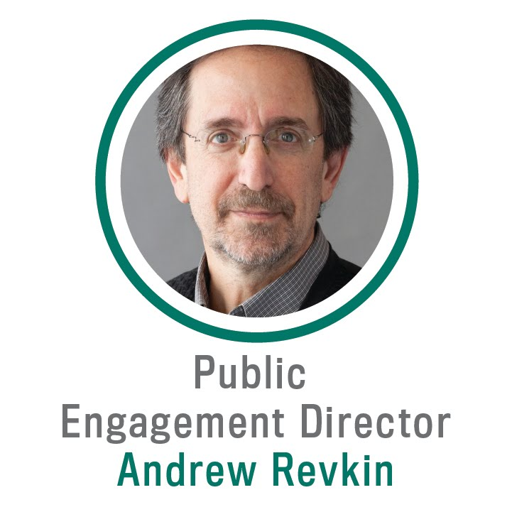
Our Knowledge Transfer Team Spans Research + Practice
Three Broad Audiences
Private Industry
Public + Media
Communities of Color +
Climate Action Communities
Our Experts
Structural + cultural racism (Cogburn)
Strategic implications of CSR (Burbano)
30+ years of climate journalism (Revkin)

Slide 39
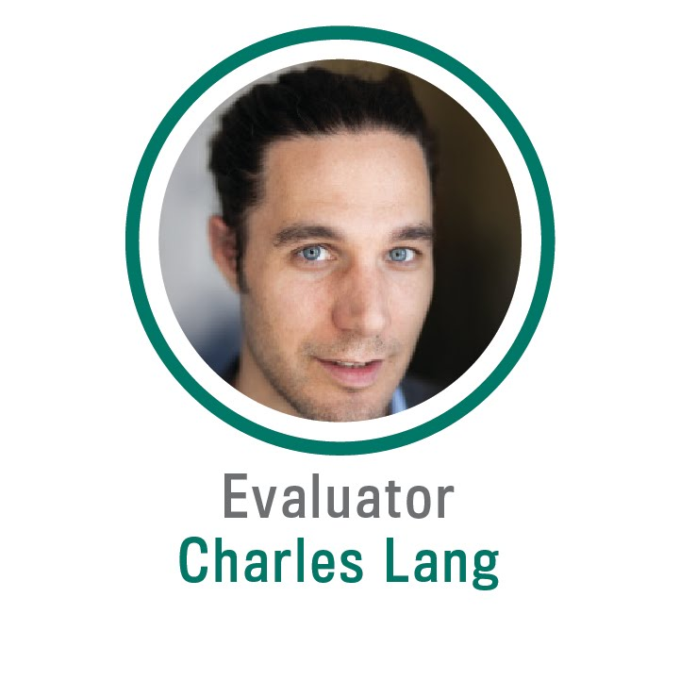
The Climate Justice Leadership Board Positions Students as Evaluators + Change Agents
President, Vice President,
Communications Director elected from + by
LEAP grad students
Partner with climate groups working with vulnerable populations + climate justice
Get trained in evaluation + assessment
  Receive supplemental funding for evaluation
Coordinate Public Conversations events
Meets monthly
Supported by Cogburn + Lang

Slide 40
“There are those who solve the problems of their disciplines and those who solve the problems of the world.”
- Unknown
This is LEAP.

Slide 41
Questions?
Feedback?

